Slide 1
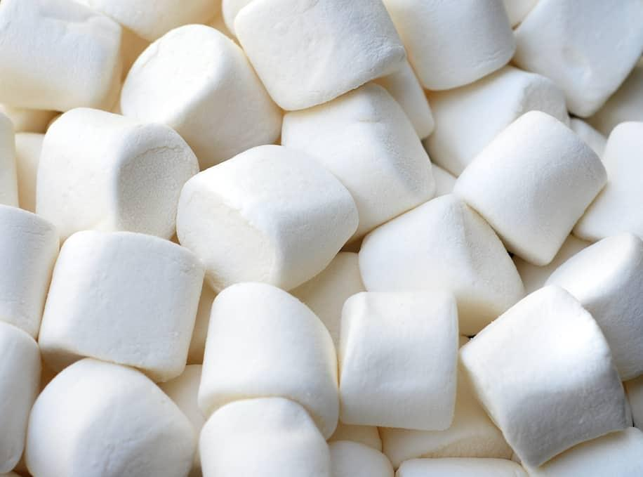

THE Marshmallow Challenge

Slide 2
The Goal
Build the tallest freestanding structure using only the materials provided in 18 minutes.

Slide 3
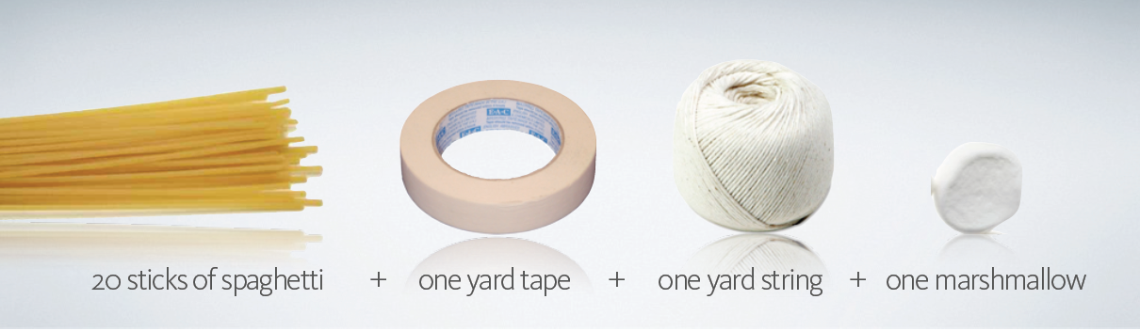
The Challenge

Slide 4
Rule #1
Build the Tallest Freestanding Structure
The winning team is the one that has the tallest structure measured from the table top surface to the top of the marshmallow.
The structure must be freestanding, meaning that it cannot be suspended from a higher structure, like a chair, ceiling or fan.

Slide 5
Rule #2
The Entire Marshmallow
Must be on Top
The entire marshmallow needs to be on the top of the structure.
Cutting or eating part of the marshmallow disqualifies the team.

Slide 6
Rule #3
Use as Much or as Little of the Kit
The team can use as many or as few of the 20 spaghetti sticks, as much or as little of the string or tape.

Slide 7
Rule #4
Break up the Spaghetti,
String or Tape
Teams are free to break the spaghetti, cut up the tape and string to create new structures.

Slide 8
Rule #5
The Challenge Lasts 15 minutes
Teams cannot hold on to the structure when the time runs out.
Teams who have members touching or supporting the structure at the end of the time will be disqualified.

Slide 9
Any Questions?

Slide 10
The Teams

Slide 11
Teams
Walid BOUZID
Rohith RAVI
Fatima Ezzarha BELKHENFAR
Zakia MOHSIN
Nathan LINTINGRE
1
2
3
Fatima Zahra ATLANE
Israel Iaac ZETINA
Said BOUCHOUKOU
Chaima IDRISSI
Viktor MANDROLKO
Oumaima ZOUHRI
Mohamed BALHOUS
Sevra CICEKLI
Jaloud Ibrahim MAIGA
Khadija EL IDRISSI
Houssam ELFENNACI
Lisa DE MEYER
4
5
6
Marta CANTINA
Alain UWADUKUNZE
Youness EL GHAZOUANI
Faratiana Herline MINOARISOA
Masuhiul HUQ
Marie-Amélie RATTE
Isibert NKENFACK
Maryam HAMSAN
Huiyuan Kelvin HAN

Slide 12
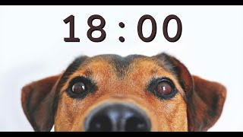
Timer starts now!

Slide 13
18 minutes

Slide 14
5 minutes

Slide 15
3 minutes

Slide 16
2 minutes

Slide 17
1 minute

Slide 18
30 seconds

Slide 19
